Slide 1
WEB222
HTML Forms & Form CSS Styling

Slide 2
Agenda
Part One
Introduction to Forms
<form element>
Input Elements
Part Two
More Form Elements
<select>, <textarea>,<button>
Grouping Fields
Labels
Styling HTML Forms Using CSS

Slide 3
Part 1
Introduction to Forms (<form element)
Input Elements

Slide 4
HTML Forms
HTML forms are web page components that are used to collect user input.
An HTML form can contain input elements / form controls, such as:
text fields, text area, buttons, checkboxes, select lists, fieldset, legend, and label.
HTML forms are originally used to pass data to a server.
The client fills out some information and then the browser sends the data from the form fields to the server for processing.
For front-end web application, HTML forms can also be used for in-browser Processing (without sending data to server).

Slide 5
HTML Forms
Examples
Oracle User Registration
Basic HTML Form

Slide 6
The <form> Element
The <form> element defines an HTML form:
HTML forms contain form elements (or form controls).
A document may have more than one form, but forms cannot be nested.
<form id="formId" method="...." action="url" >
<!-- ... -->
</form>

Slide 7
Attributes for <form> - method
The method attribute tells the server (where the request is being made) what kind of request it is.
method="get" :
This is the default. The fill-out form contents to be appended to the URL as if they were a normal query (maximum of 256 characters).
Example: simple-form-get.html
method="post" :
the fill-out form contents to be sent to the server in a data body rather than as part of the URL
Method "post" is more secure.
Example: simple-form-post.html

Slide 8
Attributes for <form> - action
The action attribute tells browser where to post the form data when the form is submitted.
action="url"
Normally, the form is submitted to a web page on a web server.
Example:
A nice URL for form get/post (& more) testing: https://httpbin.org/ (used in the above example)
action="#"
Submit to current page, used for in-browser Processing
<form action="https://httpbin.org/post" method="post">
<!-- ... -->
</form>

Slide 9
Form Elements
An HTML form can contain a number of form elements/fields/controls:
The <input> element is the one of the most-used form element.
Other form elements which are used gather or process user’s input:
<select>, <textarea>, <button>
Other elements that can be used in forms:
<fieldset>, <legend>, <label>, …

Slide 10
Form Elements - <input>
The <input> tag is used to specify a simple input element inside a form that can receive user input.
<input> tags are inline, empty tags . It may be written as <input />
type attribute.
All <input> tags are required to have a type attribute.
The type indicates what sort of input field the tag represents, such as text boxes or radio buttons.
name attribute
All <input> tags are required to have a name attribute, except for the submit and reset buttons, .
The name attribute with value determines the "property name" of the corresponding input that will be sent to the server, so if we are gathering user age, the name attribute should be set to "age", for example.

Slide 11
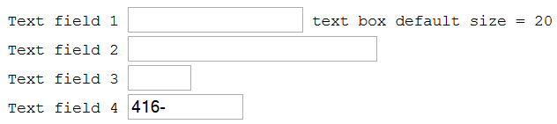
<input> type attributes - text
type="text"
A text element is a single line text input field in which the user can enter text.
type="text" is default for the tag.
Other attributes: size, maxlength
Example: input-tags-1.html
Text field 1 <input type="text" name="entry1" id="entry1" /> text box default size = 20<br />
Text field 2 <input type="text" name="entry2" id="entry2" size="30" maxlength="10" /> size="30" maxlength="10"<br />
Text field 3 <input type="text" name="entry3" id="entry3" size="5" maxlength="10" /> size="5" maxlength="10"<br />
Text field 4 <input type="text" name="entry4" id="entry4" size="12" value="416-" />

Slide 12
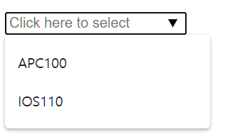
<input> type attributes - text + datalist
HTML5 <datalist> tag: specifies a list of pre-defined options for an <input type=“text”> element.
Used to provide an "autocomplete" feature on <input> elements.
Users will see a drop-down list of pre-defined options as they input data.
Example: input-tags-2.html
<input type="text" list="subjects" name="course" placeholder="Click here to select" />
<datalist id="subjects">
<option value="APC100">APC100</option>
<option value="EAC150">College English</option>
<option value="ICA002">ICA002</option>
<option value="IPC144">IPC144</option>
<option value="ULI101">ULI101</option>
<option value="IOS110">IOS110</option>
</datalist>

Slide 13

<input> type attributes - password
type="password"
A password element is a text input field in which each character typed is displayed as a character such as * or a black dot to conceal the actual value.
Example: input-tags-1.html
Type in your username <input name="username" value="Tim Hortons"/> <br />
Type in your password <input name="password" type="password"/>

Slide 14
<input> type attributes - hidden
type="hidden"
A hidden input element is an invisible element whose main purpose is to contain data that the user does not enter. This data gets sent to the server when the form is submitted.
Essentially, the type="hidden" attribute provides a way for delivering a value to the server program without the user being aware of it
Example: input-tags-1.html
<input type="hidden" name="entry0" id="entry0" value="value from the form" />
Nothing to display…

Slide 15

<input> type attributes - file
type="file"
A file element allows the user to supply a file as input. When the form is submitted, the content of the specified file is sent to the server as the value portion of the name/value pair for this input element.
A 'Browse' button is displayed next to the file input element that lets users select a file from their system to use as the value of the file input element.
If a form contains a file input element, the value of the enctype attribute of the form tag should be 'multipart/form-data'.
Example: input-tags-1.html
Student Name <input type="text" name="StudentName" id="StudentName"><br>
Upload your assignment <input type="file" name="assignment" multiple>

Slide 16


<input> type attributes - button & image
type="button"
type="image"
Places an image, serving as a custom button in place of the submit button. When a user clicks the image, the form is submitted to the server.
Example: input-tags-1.html
<input type="button" value="Press This Button" />
Search <input type="text" name="entry6" id="entry">
<input type="image" src="gogetit.gif" alt="get it">

Slide 17

<input> type attributes - submit & reset
type="submit"
When a user clicks a submit button, the form is submitted (that the action specified for the form is invoked).
Default value attribute: "Submit Query"
type="reset"
When a user clicks a reset button, all elements in the form are reset to their original values
Default value attribute: "Reset"
<input type="submit" value="Submit">
<input type="reset" value="Clear">

Slide 18
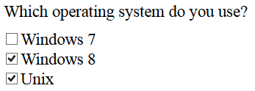
<input> type attributes - checkbox
type="checkbox"
A checkbox element is a toggle that the user can select (switch on) or deselect (switch off.)
All checkbox items should have the same name indicating they are in the same group.
Example: input-tags-2.html
NOTE: <input> is an "empty tag" – it is the "name" & "value" attributes that are sent to the server
<p>Which operating system do you use? </p>
<input type="checkbox" name="system_type" id="system_type-2" value="2" />Windows 7<br />
<input type="checkbox" name="system_type" id="system_type-3" value="3" checked />Windows 8<br />
<input type="checkbox" name="system_type" id="system_type-4" value="4" checked />Unix

Slide 19
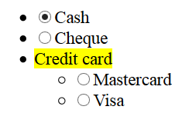
<input> type attributes - radio
type="radio"
A radio element is a radio button.
Only one radio button in the set can be selected at one time.
All radio button items must have the same name indicating they are in the same group.
Example: input-tags-2.html
<ul>
<li><input type="radio" name="paymethod" id="paymethod-1" value="cash" checked>Cash</li>
<li><input type="radio" name="paymethod" id="paymethod-2" value="cheque">Cheque</li>
<li><mark>Credit card</mark>
<ul>
<li><input type="radio" name="paymethod" id="paymethod-3" value="mastercard"> Mastercard</li>
<li><input type="radio" name="paymethod" id="paymethod-4" value="visa">Visa</li>
</ul>
</li>
</ul>

Slide 20
<input> - additional attributes
The following are additional (other than type) attributes that work with the input tag.
Global attributes: id, class, style, title, tabindex
<input> specific attributes: name, value, checked, size, maxlength, disabled, readonly.
The name & value pair in each input tag is what is going to be send to server.
Some or all of these attributes may be used depending on the value used in type attribute.
Example: input-tags-attributes.html

Slide 21
<input> - name & value attributes
name
The name attribute and a value should be present for all input tags. Otherwise, it cannot be sent to the server.
value
for a text or password entry field, can be used to specify the default contents of the field.
default value or current value
for each checkbox or radio button, value has to be specified. Otherwise no value of the button will be sent out even it is checked. Unchecked buttons are ignored when submitting the form.
for types submit and reset buttons, value is used to specify the text on the buttons.

Slide 22
<input> - checked & size attributes
checked
checked="checked" specifies that the checkbox or radio button is checked by default;
HTML5 supports attribute minimization – use checked for simplifying checked="checked".
size
is the physical size of the input field in characters;
this is appropriate for text entry fields and password entry fields.
If this is not present, the default is 20 characters.
This can be set using CSS with the "width" property as well

Slide 23
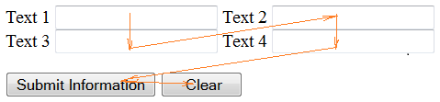
<input> - maxlength & tabindex
maxlength
is the maximum number of characters that are accepted as input; this is only appropriate for single-line text entry fields and password entry fields.
If this is not present, the default will be unlimited.
The text entry field will scroll appropriately if maxlength value is greater than the size value.
tabindex
tabindex="nn" - nn is a positive value - navigation proceeds from the element with the lowest tabindex value to the element with the highest value.
is a global attribute (ie: all elements can have a "tabindex").
Example: tabindex.html

Slide 24
<input> - disabled, readonly & autocomplete
disabled
disabled="disabled" - When used, cannot receive user input nor will its value be submitted to server with the form
readonly
readonly="readonly" - When used, cannot receive user input - the value is submitted to server with the form
autocomplete
Specifies whether a HTML form or its form elements have autocomplete on or off.
Example: autocomplete.html

Slide 25

HTML5 Form input Types & Attributes
HTML5 introduces many semantic input types to replace the “text” type.
The new input types include: email, url, tel, number, range, date, month, week, time, datetime, color, search
e.g.
No matter what type it is, the value is always "text".
HTML5 also supports some new attributes for form input elements.
autofocus, placeholder, required
<input type="number" name="even" min="2" max="100" step="2" />

Slide 26
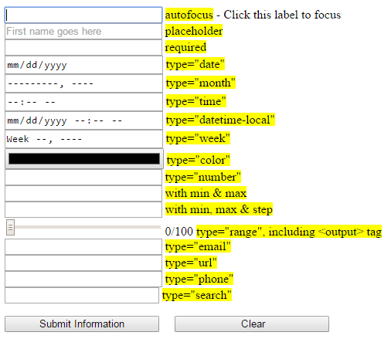
HTML5 Form input Types & Attributes
Example: input-tags-html5.html

Slide 27
Part 2
More Form Elements (<select>, <textarea>, <button>)
Grouping Fields
Labels
Styling HTML Forms Using CSS

Slide 28
More Form Elements
In addition to <input> element, some elements can be used inside a form to accept user input:
<select> element
with <option> and <optgroup> elements
<textarea> element
<button> element

Slide 29
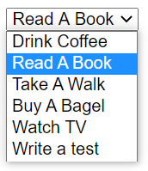
<select> Element
The <select> element is used to create a drop-down list/menu, from where a user can select one or more options.
<select name="what-to-do" id="what-to-do">
<option value="1"> Drink Coffee </option>
<option value="2" selected> Read A Book </option>
<option value="3"> Take A Walk </option>
<option value="4"> Buy A Bagel </option>
<option value="5"> Watch TV </option>
<option value="6"> Write a test </option>
</select>

Slide 30
<select> Element
The selection list itself is defined by a series of <option> tags.
The name to the <select> tag applies to the entire list. While the values apply to the option tags.
If more than one option is selected in the list, the options are all sent to the server under that one variable name as a comma separated list.

Slide 31
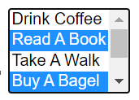
<select> tag attributes
multiple="multiple"
allows users to select more than one option, usually by holding down the Control key while clicking on additional choices.
Otherwise the selection functions like radio buttons where selecting one deselects another.
<select name = "what-to-do" id = "what-to-do" multiple="multiple">
<option value = "1"> Drink Coffee </option>
<option value = "2" selected> Read A Book </option>
<option value = "3"> Take A Walk </option>
<option value = "4"> Buy A Bagel </option>
<option value = "5"> Watch TV </option>
<option value = "6"> Write a test </option>
</select>

Slide 32

<select> tag attributes
size="n"
specify how many lines are displayed in the selection menu.
If the size is not specified or if size="1", a single line is displayed and the selection menu functions as a drop down menu.
If a number larger than one (1) is specified, then the menu functions as a scrollable list.
<select name = "what-to-do" id = "what-to-do" size = 3>
<option value = "1"> Drink Coffee </option>
<option value = "2" selected> Read A Book </option>
<option value = "3"> Take A Walk </option>
<option value = "4"> Buy A Bagel </option>
<option value = "5"> Watch TV </option>
<option value = "6"> Write a test </option>
</select>

Slide 33
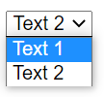
<option> Element
The <option> element is nested inside the <select> element to provide readable "text" options
The value attribute is the value that is returned by selecting that option.
If a <option> tag’s value attribute is not provided, its text will be come the value.
<select name="thename">
<option value="1">Text 1</option>
<option value="2">Text 2</option>
</select>

Slide 34
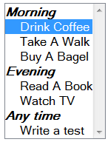
<select> Element with <optgroup>
The <optgroup> tag to group things by category.
<select name="what-to-do" id="what-to-do" multiple size=9>
<optgroup label="Morning">
<option value="1" selected="selected"> Drink Coffee </option>
<option value="2"> Take A Walk </option>
<option value="3"> Buy A Bagel </option>
</optgroup>
<optgroup label="Evening">
<option value="4"> Read A Book </option>
<option value="5"> Watch TV </option>
</optgroup>
<optgroup label="Any time">
<option value="6"> Write a test </option>
</optgroup>
</select>
Example: select-tags-optgroup.html

Slide 35
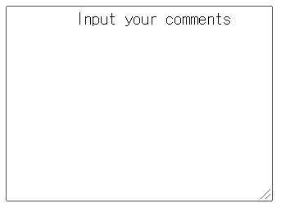
<textarea> Element
The <textarea> element provides a multi-line text entry field.
attributes:
rows = "height of the textarea in character"
cols = "width of the textarea in character"
NOTE: This can also be set using the CSS properties, width & height
textarea fields automatically have scroll bars; any amount of text can be entered in them.
The element can have "text" as default contents. E.g.
Example: textarea.html
<textarea name="comments" cols="30" rows="10"> Input your comments </textarea>

Slide 36

<button> Element
The <button> element provides an alternative (more flexible) way to perform form submits/resets as well as providing a generic button that we can use for interactivity
Syntax:
<button> content showing on button </button>
Type attributes:
<button type="submit">
<button type="reset">
<button type="button">
Example:
<button type="button" onclick="console.log('Button was clicked!');">Click Me!</button>

Slide 37
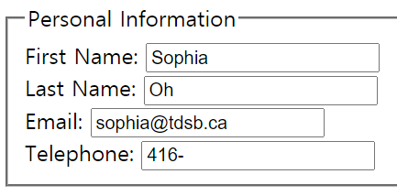
Grouping Fields
<fieldset> tags: grouping the fields
<legend> tags: specifying a title for the group
Example: fieldset-label-button.html
<fieldset>
<legend>Personal Information</legend>
First Name: <input type="text" name="fname" id="fname" /><br>
Last Name: <input type="text" name="lname" id="lname" /> <br>
Email: <input type="email" name="name3" id="email" /> <br />
Telephone: <input type="tel" name="phone" id="phone" value="416-"/>
</fieldset>

Slide 38
<label> Element
Define a label for an <input> element.
It does not render as anything special for the user.
It provides a usability improvement for mouse users,
if the user clicks on the text within the <label> element, it toggles the control.
The for attribute of the <label> tag should be equal to the id attribute of the related element to bind them together.
Example: fieldset-label-button.html

Slide 39
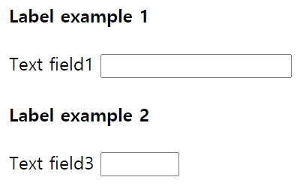
<label> Element
Example: fieldset-label-button.html
<h4>Label example 1</h4>
<div>
<label for="entry1" title="Free format">Text field 1</label>
<input type="text" name="entry1" id="entry1" />
</div>
<h4>Label example 2</h4>
<p>
<label for="entry3" title="Label for entry3">
<span>Text field 3 </span>
<input size="5" name="entry3" id="entry3" /><br />
</label>
</p>

Slide 40

<label> Element for checkbox & radio
The label element can also be used effectively for checkbox & radio inputs.
Clicking the label toggles the control (checks / unchecks it), so it makes them easier to use.
This can be done by using <label for="">…</label>:
Or by wrapping the whole element inside a <label>…</label> element:
Example: label-radio-checkbox.html
<input type="checkbox" name="system_type" id="system_type-1" value="1" /><label for="system_type-1">Windows 7</label>
<label><input type="checkbox" name="system_type" id="system_type-3" value="3" checked />Unix</label>

Slide 41
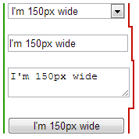
Styling HTML Forms Using CSS
Issues:
HTML table is not appropriate for aligning form elements.
Not all form elements are created equal when CSS is involved.
Some elements are easy to style with CSS, but some other elements simply can't be styled using CSS.
Browsers are often inconsistent in rending font and text.
button, input, select, textarea
{
font-family : inherit;
font-size : 100%;
width : 150px;
}

Slide 42
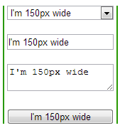
Styling HTML Forms Using CSS
CSS box-sizing property:
"box-sizing: border-box; " can be used to give the same size to several different form elements.
Example:
CSS property "display:inline-block;"
<label> and <span> are inline-level elements, so width and height are available to them.
"display: inline-block;" can be used to inline-level elements in order to set dimensions (width and height) to them.
Example:
input, textarea, select, button {
width : 150px;
margin: 0;
box-sizing: border-box;
}
label { display: inline-block; width: 100px; text-align: right; }

Slide 43
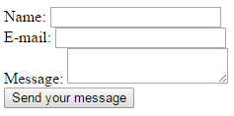
An example form with CSS
<form action="https://httpbin.org/post" method="post">
<div>
<label for="name">Name:</label>
<input type="text" id="name" />
</div>
<div>
<label for="mail">E-mail:</label>
<input type="email" id="mail" />
</div>
<div>
<label for="msg">Message:</label>
<textarea id="msg"></textarea>
</div>
<div class="button">
<button type="submit">Send your message</button>
</div>
</form>
(Before CSS is applied)

Slide 44
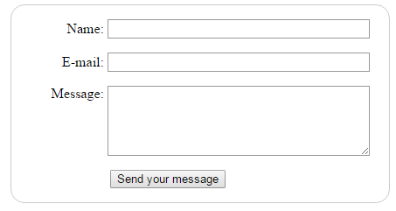
An example form with CSS
<form action="https://httpbin.org/post" method="post">
<div>
<label for="name">Name:</label>
<input type="text" id="name" />
</div>
<div>
<label for="mail">E-mail:</label>
<input type="email" id="mail" />
</div>
<div>
<label for="msg">Message:</label>
<textarea id="msg"></textarea>
</div>
<div class="button">
<button type="submit">Send your message</button>
</div>
</form>
(After CSS is applied)
Example: form-with-css.html
Example 2 (MDN): Payment Form

Slide 45
More on CSS Selectors
Type of Selectors [bold: covered so far]
Type selector (tag selector)
Class selector
ID selector
Selector grouping
Universal selector
Attribute selector
Combinators
Descendant selector (contextual selectors)
Child selector
Adjacent sibling selector
General sibling selector
Pseudo-classes
Pseudo-elements

Slide 46
Selectors
Universal selector
The universal selector matches any element type.
e.g.
Attribute selector
An attribute selector will match elements on the basis of either
the presence of an attribute, or
the exact or partial match of an attribute value.
e.g.
* { margin: 0; padding: 0; }
[href] { color: yellow;}
a[href] {color: yellow;}
input[type="submit"] { border: 2px solid #ccc;}
[class="warning"] { background-color: yellow; }

Slide 47
Selectors
Combinators - Selectors based on relationships
Descendant selector (contextual selectors)
e.g.
Child selector
e.g.
Adjacent sibling selector
e.g.
General sibling selector
e.g.
div span { line-height: 90%; } /* includes child */
ul>li { text-decoration: underline; }
h2+p { color: blue; } /* matches all p elements that appear immediately after h2 elements.*/
h2~p { color: blue; }

Slide 48
Selectors
Pseudo-class selector
A pseudo-class is similar to a class in HTML, but it’s not specified explicitly in the markup.
:active, :hover, :link, :visited, :focus, :first-child, …
Pseudo-element selector
allow you to style certain parts of a document:
CSS2
:after, :before, :first-letter, :first-line, :selection
CSS3
::after, ::before, ::first-letter, ::first-line, ::selection
Example: morecss.html
CSS Selector Reference

Slide 49
HTML Form Summary
Form element:
<form method="post" action="url" > …
</form>
Form elements/controls:
<input> type =:
Textboxes: text, password, email, file, color, date, time, number, url, tel, …
Selections: checkbox, radio
Buttons: submit, reset, image, button
Other elements:
<select> with <option>, <textarea>, <button>.
<fieldset>, <legend>, <lable>, …

Slide 50
Useful Resources
W3C HTML5 DOC: Forms
MDN: Forms in HTML
How to structure an HTML form
Selectors - Web developer guide | MDN
Web Dev Tool: Firefox Style Editor

Slide 51
Questions?
Any questions?
Would you like to see any more examples?

